Slide 1
Sort 59.5
 | Bulk | Heavy | Medium | Light
Weight (g) | 298 | 280 | 16.5 | 2.01
Vol (mL) | 390
Bulk Density (g/mL) | 0.771
Proportion (%) | 100 | 93.8 | 5.53 | 0.67
AF (ppb)

Slide 2
Sort 57
 | Bulk | Heavy | Medium | Light
Weight (g) | 297 | 249 | 45.7 | 2.53
Vol (mL) | 400
Bulk Density (g/mL) | 0.743
Proportion (%) | 100 | 83.8 | 15.4 | 0.85
AF (ppb)

Slide 3
Sort 55
 | Bulk | Heavy | Medium | Light
Weight (g) | 297 | 242 | 50.3 | 5.02
Vol (mL) | 425
Bulk Density (g/mL) | 0.700
Proportion (%) | 100 | 81.4 | 16.9 | 1.69
AF (ppb)

Slide 4
Unsort
 | Bulk | Heavy | Medium | Light
Weight (g) | 297 | 262 | 30.4 | 2.79
Vol (mL) | 410
Bulk Density (g/mL) | 0.723
Proportion (%) | 100 | 88.8 | 10.3 | 0.95
AF (ppb)

Slide 5
RxR non-inoc
 | Bulk | Heavy | Medium | Light
Weight (g) | 301 | 287 | 12.4 | 2.33
Vol (mL) | 370
Bulk Density (g/mL) | 0.814
Proportion (%) | 100 | 95.1 | 4.11 | 0.77
AF (ppb)

Slide 6
RxR inoc
 | Bulk | Heavy | Medium | Light
Weight (g) | 302 | 291 | 10.2 | 1.12
Vol (mL) | 370
Bulk Density (g/mL) | 0.817
Proportion (%) | 100 | 96.3 | 3.37 | 0.37
AF (ppb)

Slide 7
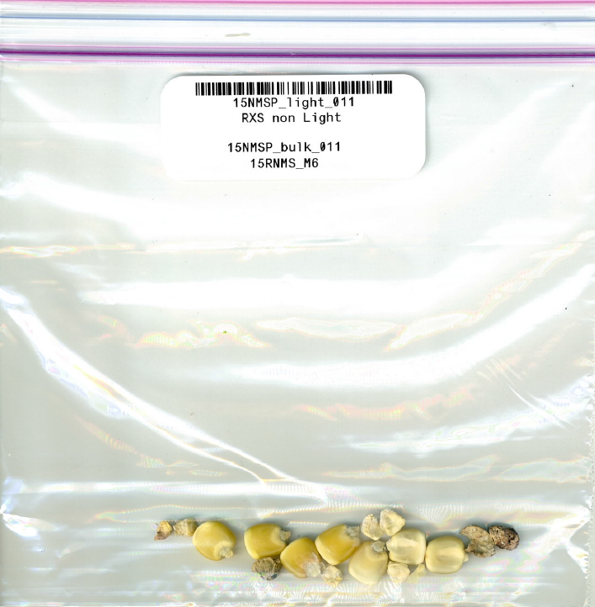
RxS non-inoc
 | Bulk | Heavy | Medium | Light
Weight (g) | 309 | 296 | 9.32 | 3.21
Vol (mL) | 395
Bulk Density (g/mL) | 0.783
Proportion (%) | 100 | 95.9 | 3.02 | 1.04
AF (ppb)

Slide 8
RxS inoc
 | Bulk | Heavy | Medium | Light
Weight (g) | 306 | 295 | 9.68 | 1.37
Vol (mL) | 395
Bulk Density (g/mL) | 0.775
Proportion (%) | 100 | 96.4 | 3.16 | 0.45
AF (ppb)

Slide 9
SxS non-inoc
 | Bulk | Heavy | Medium | Light
Weight (g) | 299 | 281 | 16.1 | 1.52
Vol (mL) | 390
Bulk Density (g/mL) | 0.766
Proportion (%) | 100 | 94.1 | 5.39 | 0.51
AF (ppb)

Slide 10
SxS inoc
 | Bulk | Heavy | Medium | Light
Weight (g) | 301 | 288 | 11.1 | 1.70
Vol (mL) | 390
Bulk Density (g/mL) | 0.772
Proportion (%) | 100 | 95.7 | 3.69 | 0.57
AF (ppb)

Slide 11
074
 | Bulk | Heavy | Medium | Light
Weight (g) | 240 | 235 | 3.15 | 1.75
Vol (mL) | 305
Bulk Density (g/mL) | 0.788
Proportion (%) | 100 | 98.0 | 1.31 | 0.73
AF (ppb)

Slide 12
036
 | Bulk | Heavy | Medium | Light
Weight (g) | 301 | 295 | 3.79 | 1.49
Vol (mL) | 390
Bulk Density (g/mL) | 0.771
Proportion (%) | 100 | 98.2 | 1.26 | 0.50
AF (ppb)

Slide 13
024
 | Bulk | Heavy | Medium | Light
Weight (g) | 286 | 273 | 10.0 | 2.33
Vol (mL) | 375
Bulk Density (g/mL) | 0.763
Proportion (%) | 100 | 95.7 | 3.50 | 0.82
AF (ppb)

Slide 14
073
 | Bulk | Heavy | Medium | Light
Weight (g) | 295 | 283 | 9.11 | 2.55
Vol (mL) | 385
Bulk Density (g/mL) | 0.767
Proportion (%) | 100 | 96.0 | 3.09 | 0.87
AF (ppb)

Slide 15
060
 | Bulk | Heavy | Medium | Light
Weight (g) | 299 | 292 | 4.42 | 2.86
Vol (mL) | 385
Bulk Density (g/mL) | 0.775
Proportion (%) | 100 | 97.6 | 1.48 | 0.96
AF (ppb)

Slide 16
090
 | Bulk | Heavy | Medium | Light
Weight (g) | 260 | 256 | 3.13 | 0.853
Vol (mL) | 320
Bulk Density (g/mL) | 0.812
Proportion (%) | 100 | 98.5 | 1.20 | 0.33
AF (ppb)

